Slide 1

MGM Institute of Physiotherapy
Aurangabad
MAHATMA GANDHI MISSION
Didactic Lecture

Slide 2
Hand & Wrist Complex
Dr. surendra Wani
Dept. Of Musculoskeletal Physiotherapy
MGM Institute Of Physiotherapy
Chh. Sambhajinagar

Slide 3
Objectives
To understand and learn to assess the Wrist and hand joint subjectively and objectively.

Slide 4
Content :-
Introduction
Subjective Assesment
Objective Assesment
Investigations

Slide 5
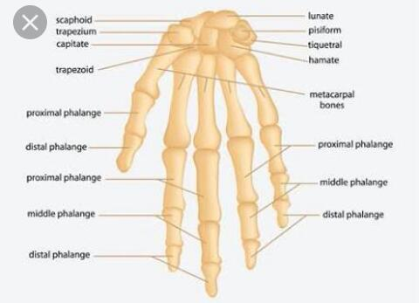
Introduction

Slide 6
Demographic Data
Age
Occupation
History of present illness-
1.Mechanism of injury?
2.Ask about functional ability?
3.Which hand is dominant?

Slide 7
Pain Assesment-
1.What type of pain it is?
2.Once pain started ask about duration of pain?
3.Does pain is with abnormal sensation?
Behaviour of Pain-

Slide 8
Special Questions-
X-ray
MRI
Past History
Drug History
Personal History
Occupational History
Socio-economic History

Slide 9
On Observation-
Posture
Observe ability to use hand
Observe normal attitude of hand and compare affected side with unaffected side
Observation of contracture
Observation of Muscle wasting of thenar and hypothenar muscles
Observation of ganglion,colour changes,nail bed and deformities of hand

Slide 10
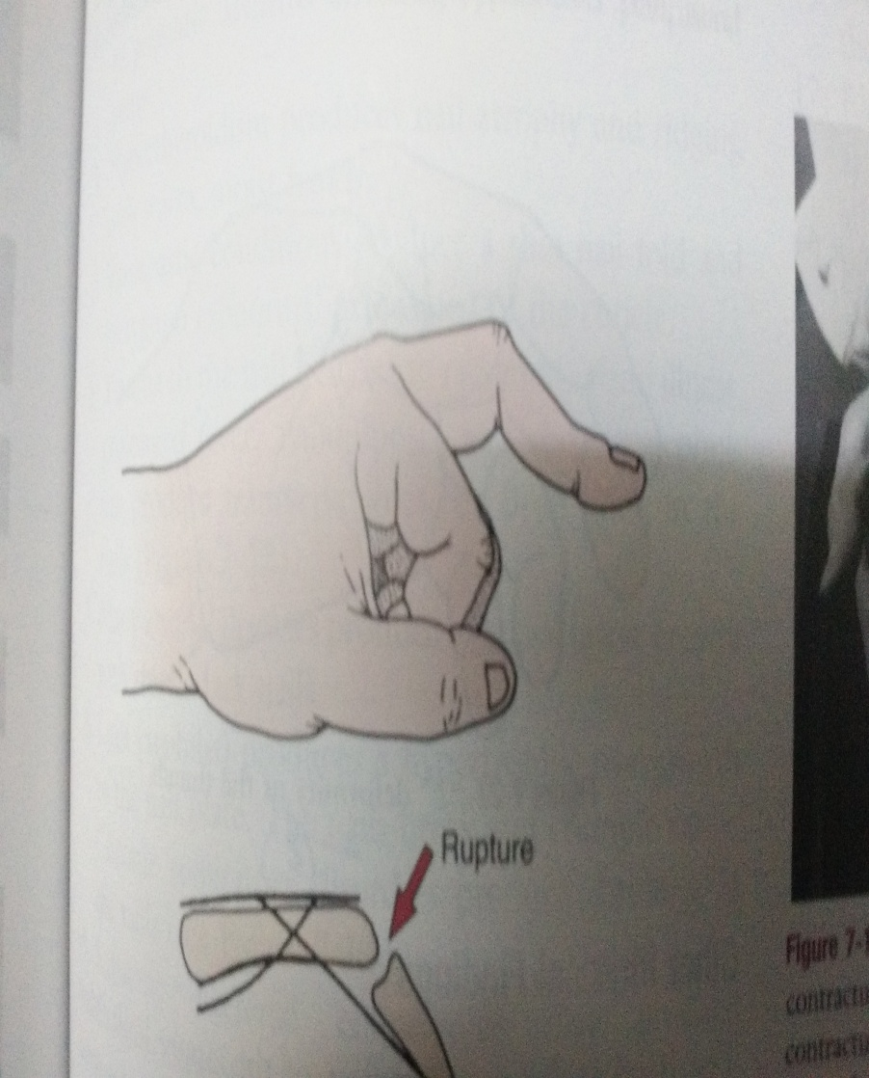
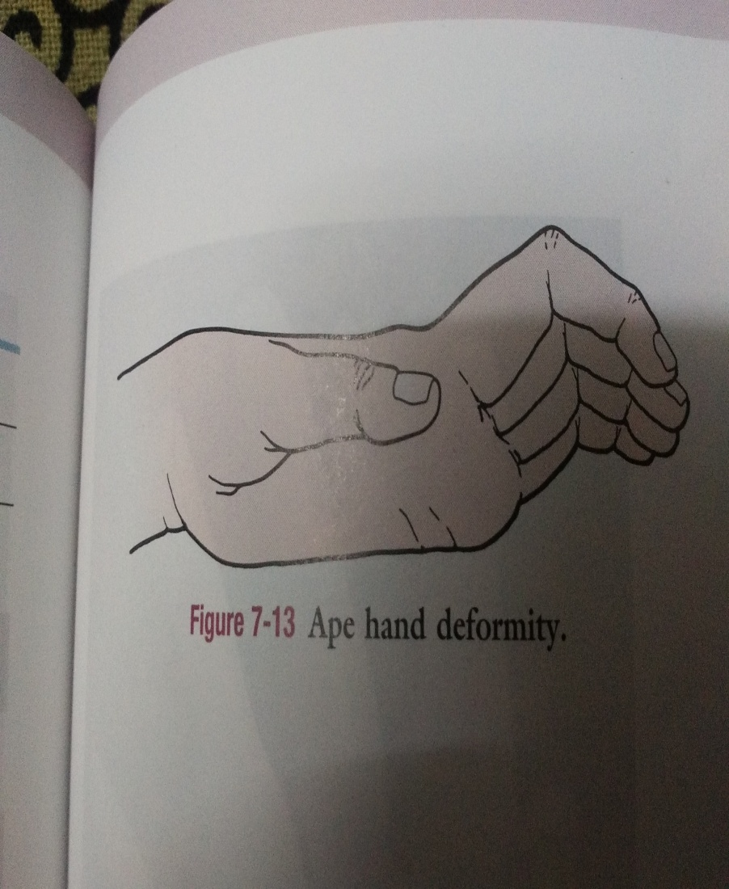
Deformities Of Hand-

Slide 11
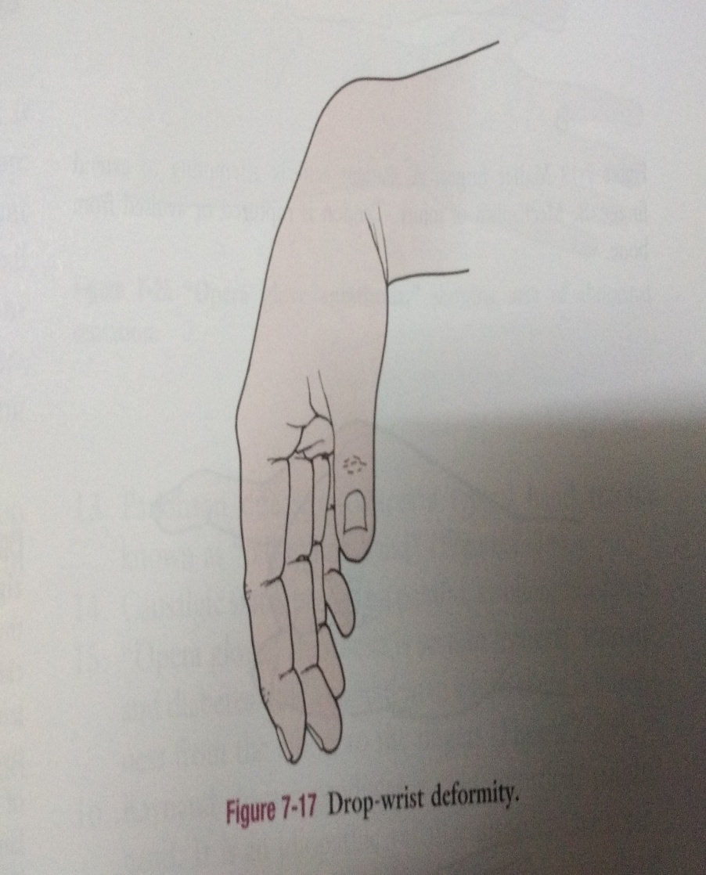
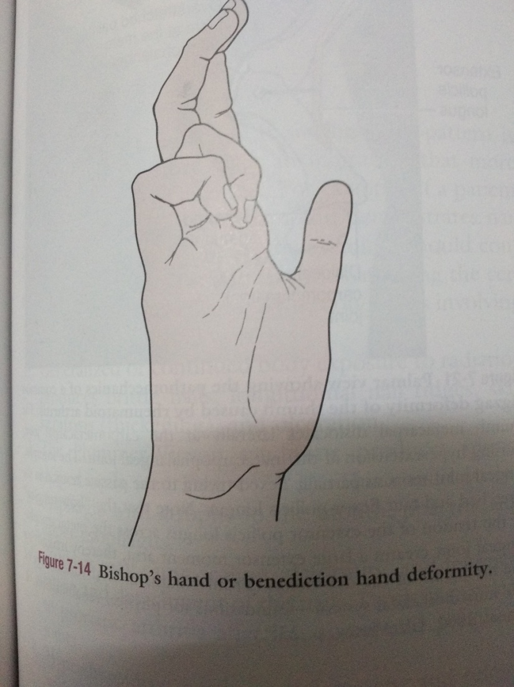

Slide 12
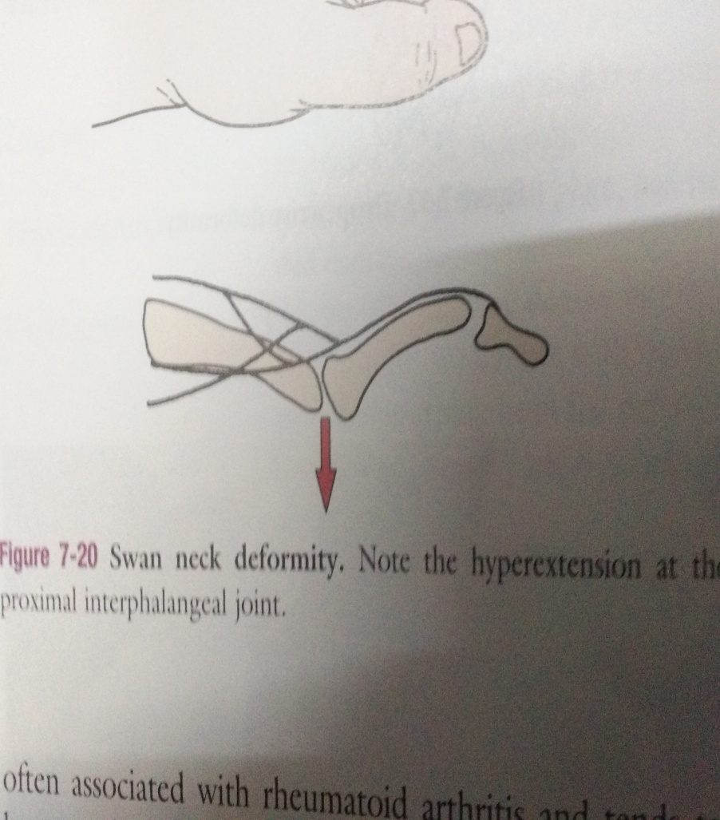
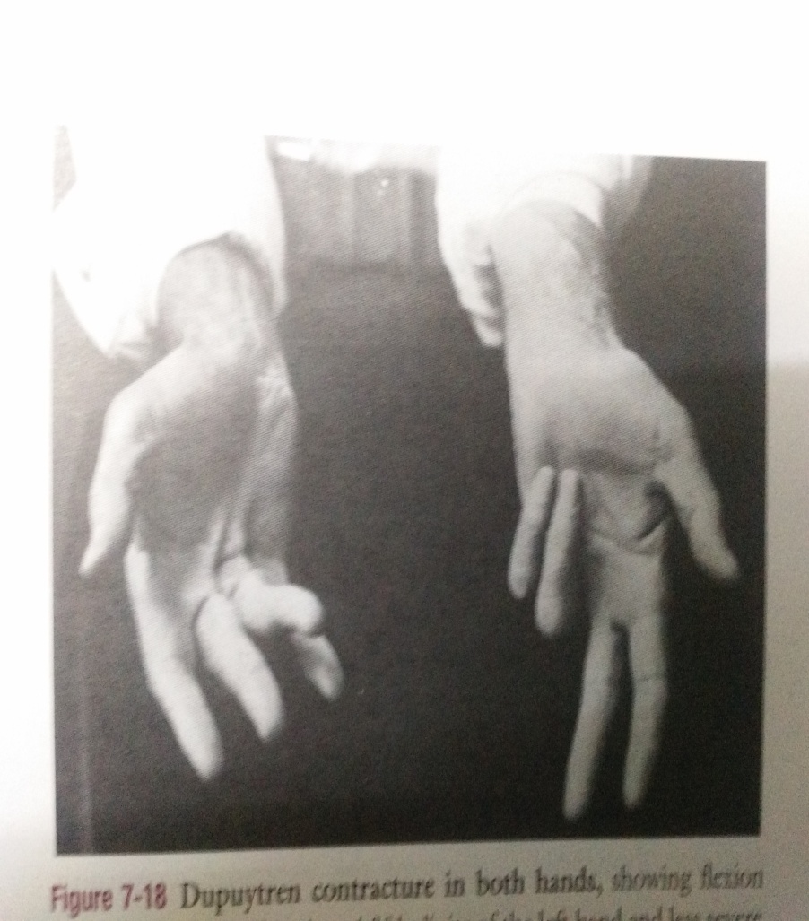

Slide 13
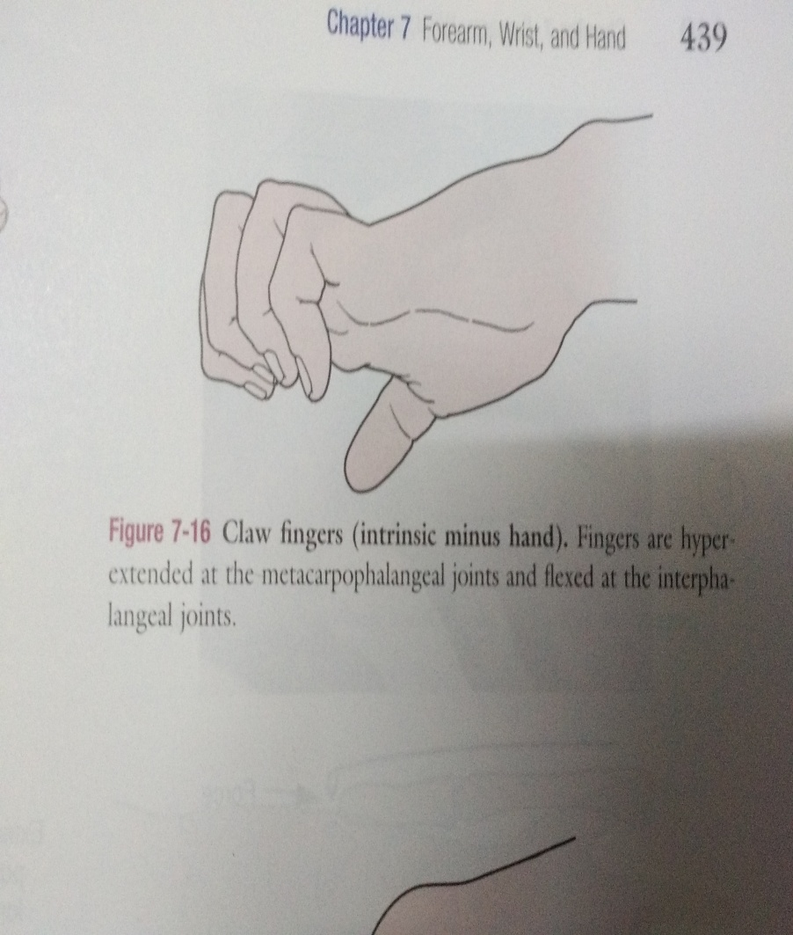
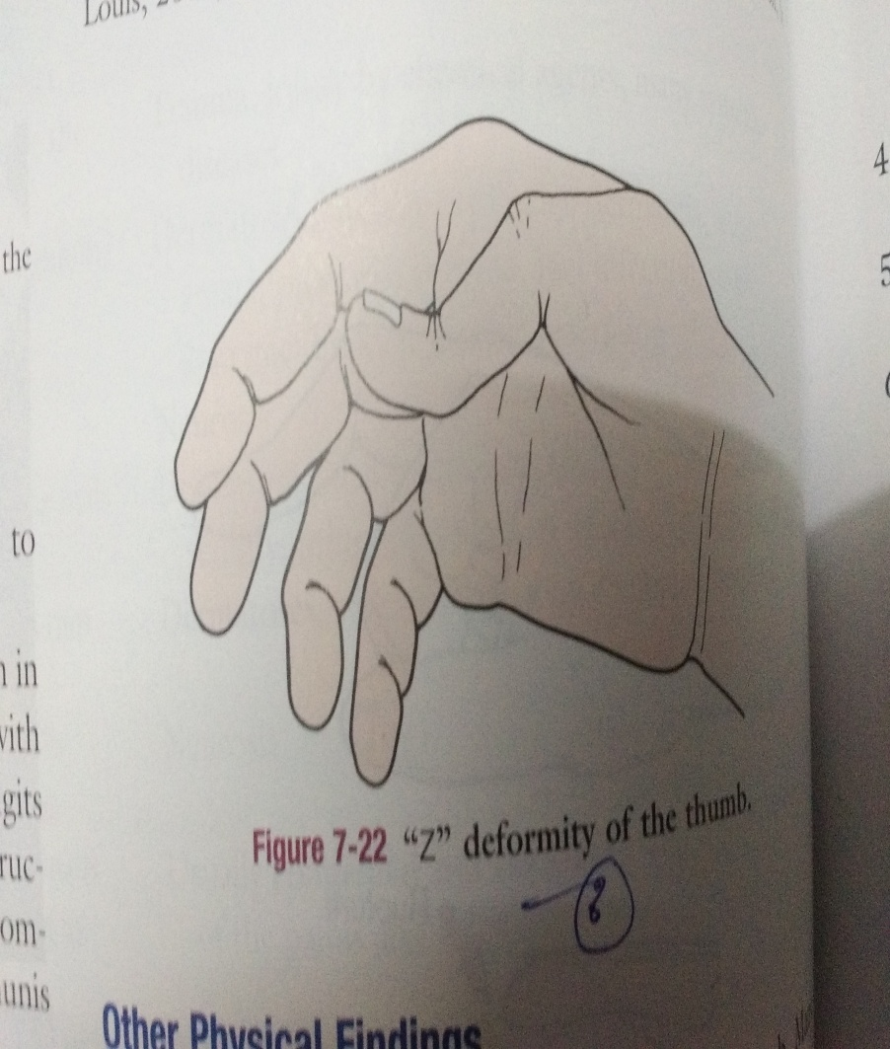

Slide 14
Local physical Examination-
On Inspection
IS any swelling present around wrist
Examiner should noted any rotational deformities of fingers
Look for normal & abnormal contours
Examiner should note wounds & scar

Slide 15
Sensory examination:
Superficial & deep sensations
Abnormal sensations

Slide 16
Joint Examination
Active movements wrist
Flexion:-80-90
Extention:-70-80
Finger MIP Flexion:-85-90
Finger MIP Extention:-30-45

Slide 17
Functional Assessment
Functional Impairment,-
-loss of thumb function affects about 40%to50%of hand function
-Loss of index finger function accounts for 20%hand function
-Middle finger also 20%,Ring finger10% ,little finger10%
Grips & Pinch strength
Types of Grips
Types of pinches

Slide 18
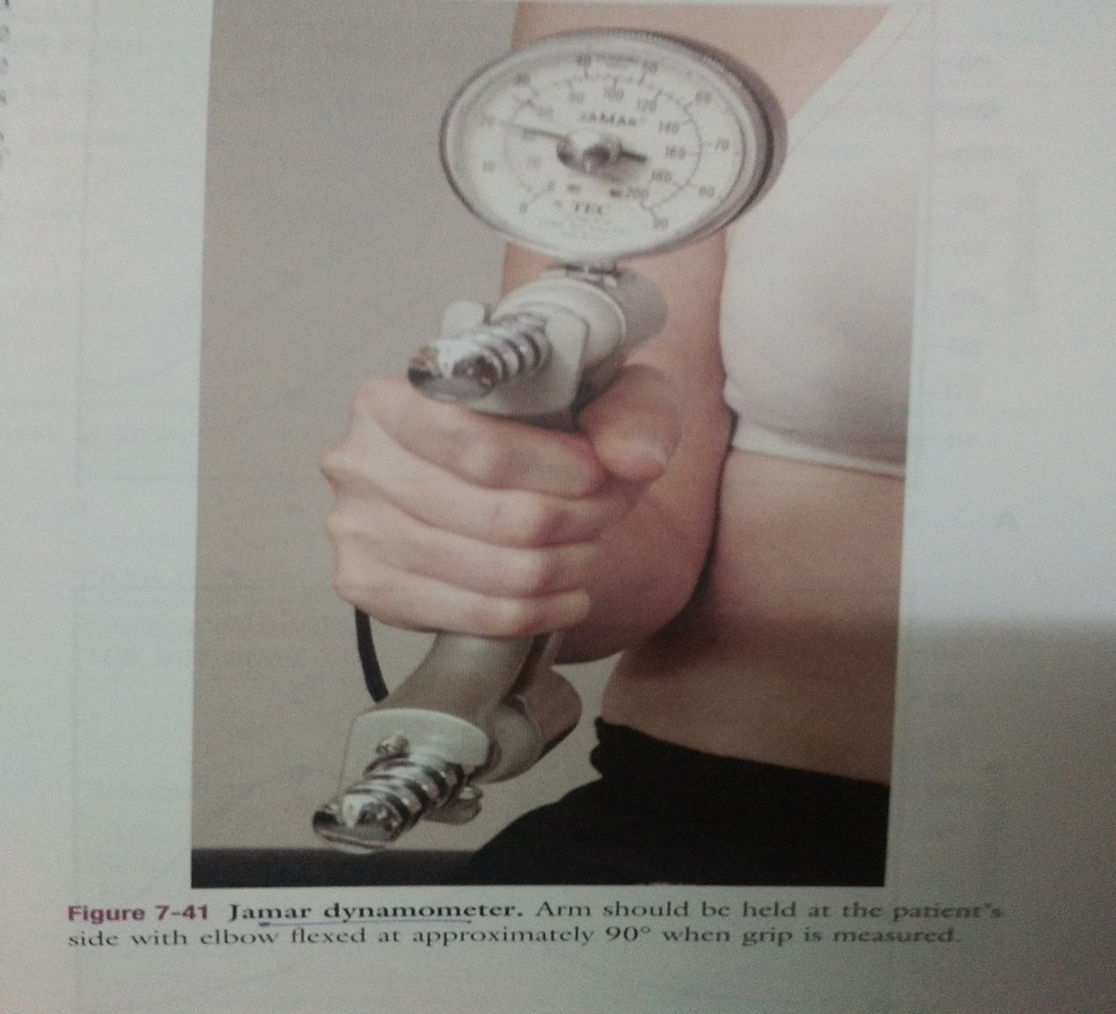
Jamar Dynamometer-

Slide 19
Summary & Questions
Describe various types of prehension and precisions. 7 marks
Types of grips and pinches. 7 marks

Slide 20
THANK YOU

